Slide 1
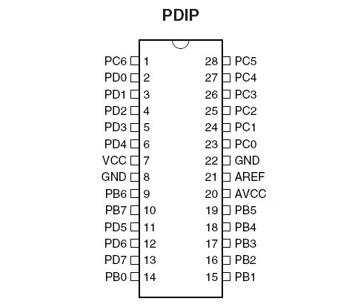
Reset
Reset/LCD_RW
LCD_RS
AI5
DP0
RX
LCD_EN
AI4
DP1
TX
RGB_Red
AI3
USB_D+
RGB_Green
AI2
DP3
BL/INT
RGB_Blue
AI1
USB_D-
Sensor
AI0
Atmega 8/168/328
XTAL1
XTAL2
LCD_D4
DP13
DP5
LCD_D5
Buzzer
DP12
DP6
LCD_D6
LED4/Speaker
DP11
DP7
LCD_D7
LED3
DP10
DP8
LED1
LED2
DP9
www.diy.ind.in

